Slide 1

Using genetic algorithms to find technical trading rules
IME672A : Data Mining
Group - Presentation

Slide 2
GROUP
TEAM MEMBERS
Maneesh Kumar | 13381
Siddharth Saurav
Nikhil Sahu
Anshul Gautam
Varun Rathi

Slide 3
Introduction
Rules prediction for S&P index based on previous years prices, some macroeconomics terms and transition cost using genetic algorithm.
Identification of “in” and “out” situation based on volatility and daily returns.
Rules for returns above the buy-and-hold strategy.
Identification of high return and low volatility period.
Why genetic algorithm
- can work on old data.
- avoids a potential bias caused by ex post selection.

Slide 4
Genetic Algorithms
Rules based algorithm
- Define initial rules (parents rules) and find best rules based on fitness function.
- Create new rules (offspring) from parents and replace weak parent rules.
Genetic programming
- Based on decision tree and building blocks
- Consider decision tree as a rule and apply rule based algorithm.
- Exchange same type of sub-trees to perform offspring.

Slide 5
Trading Rules
Ex ante optimal trading rules:-
- only rules structure is important.
- create structural function only(finding local minima/maxima etc.
- use more traditional and optimal rules to avoid data snooping.
Genetic algorithm to trading rules
- decision rules:- decide “in” and “out” condition(class label).
- trading rules:- decide “sell” and “buy” signal.
- trading strategy :- if ( in && sell) switch to out;
if ( out && buy) switch to in;
else do nothing.

Slide 6
Trading Rules
- Trade functions:- Boolean and real.
- closing price=f(price), day_lag=f(lag) etc.
< >
average price price maximum
50 30
moving avg. rule trading range rule
- new rules using functions and genetic trees.

Slide 7
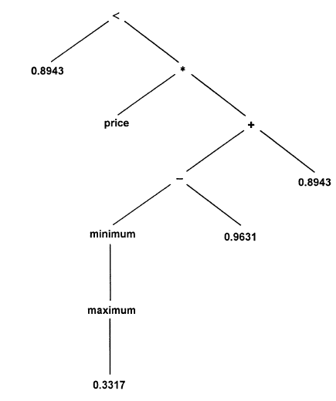
Examples of trading rules
Price* minimum(price) – 0.0688*price > .8963 ( normalize price are above .89)
set day=0 if signal=“buy”;
end while signal=“sell”;
-continue it for other rules.
AND
set day=0 if signal=“sell”
end while signal=“buy”
- continue it for others rules.
tree structure of trading rule for 1964-1968.

Slide 8
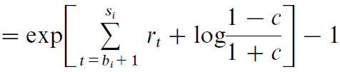


Fitness Measure
Fitness measure
- excess return over the buy-and-hold strategy during training period.
Πi
c = transaction cost , Pt = closing price on day t , Πi = simple return.

Slide 9
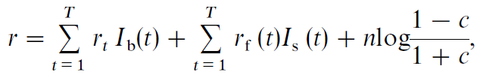
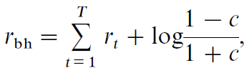

Fitness Measure
- continuously compounded return(r)
return for the buy-and-hold strategy
Excess return or fitness
rf (t) = risk free rate on day t, T = trading days, n = no. of trades.
Ib (t) and Is (t) are buy and sell indicators.

Slide 10
DATA Visualization
Time division of data
- training period:- period to develop new rules.( five years in our case)
- selection period:- period to select best fitted rules.( two years )
- test period:- period to check if given rules is better than buy-and-hold strategy.
(remaining years )
Data limitations
- population of size 500.
- maximum genetic structure node = 100.
- maximum level of nodes = 10.
- Evolution continues for a maximum of 50 generations, or until there is no improvement for 25 generations.

Slide 11
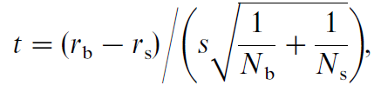
Results of data visualization (c=.25%)
89 trading rules in the 100 trials ( -ve return rules are excluded )
Excess returns are predominantly negative.
trading frequency is relatively low ( avg. n= 3.8 per year ).
rules are long in the market for 57% of the days. ( in days/ total days ).
results are generally consistent, except 1929-1935 and 1969-1975 (Ns > Nb).
Return during in period is higher and during out is lower. The difference(t)
s = samples s.d.
rb and rs are return of in and out, Nb and Ns are no. of in and out days,

Slide 12
Effects of trading cost
low trading cost
high trading frequency
+ve avg. excess return for most of the rules
r is +ve for most of the cases
higher returns and better forecasting ability
Volatility and trading days are unaffected
High trading cost
Low trading frequency
-ve avg. excess return for most of the rules
r is –ve for most of the cases
lower returns and poor forecasting ability
same here

Slide 13
Forecasting based on volatility
Low volatility gives less risk
Expected volatility:- related to expected excess return
Upward volatility forecasting:- if( volatility > expected volatility)
- chance of high return in future but low stock prices in present gives low return
Downward volatility forecasting:- if( volatility < expected volatility )
- chance of lower return in future but high stock prices in present gives high
return.
low volatility leads to high investment.

Slide 14
Robustness of the Results
Measuring robustness by incorporating a lag of one day in the implementation of trades.
- average(rb-rs) falls from seven to two basis points.
- low trading cost has a little difference between rb and rs.
- patterns for reduced volatility still holds.
Results are more robust for high trading cost.
One day delay to trading signal remove most of forecasting ability.

Slide 15
Conclusions
Most of the trades are profitable without trading cost.
Rules take long position when return is +ve and daily volatility is low, stay out of
the market if volatility is high.
In equilibrium, positive return is related to volatility.
Stay in the market if risk is low.

Slide 16
-Thank You

